Slide 1
From Power Over to Power With: Applying Trauma Informed Care To Our Work
Elizabeth Eastlund,LCSW
Executive Director, Rainbow services
Amy turk, lcsw
Chief Program officer, Downtown Women’s center

Slide 2
What is Trauma?
“Psychological trauma is an affiliation of the powerless. At the moment of trauma, the victim is rendered helpless by overwhelming force. When the force is that of nature, we speak of disasters. When the force is that of other human beings, we speak of atrocities. Traumatic events overwhelm the ordinary systems of care that give people a sense of control, connection, and meaning.“
- Judith Herman

Slide 3
Other definitions of Trauma
"...a trauma is any event or experience of sufficient force or magnitude that it overwhelms the capacity of the individual to absorb the experience and continue essentially unaffected, and which therefore results in a significant reduction or distortion of the individual’s ability to carry on with normal behaviour, and to function adequately in their lives.“
-Robin Johnson

Slide 4
Trauma Informed Care – a Cultural Shift
From asking: “What is wrong with you?”
To: “What Happened to You?”
From Power OVER
to Power WITH

Slide 5
What is Trauma Informed Care?
"Trauma Informed Services assume that people are doing the best they can at any given time to cope with the life altering and frequently catastrophic effects of trauma. Because victimization can lead to disconnection with self and isolation from others, the challenge is to develop services that create authentic reconnection, reparation, and healing.”
A Long Journey Home; A guide for creating Trauma-Informed Services for Mothers and Children experiencing Homelessness

Slide 6
Guiding Principles of TIC
SAFETY
Trustworthiness and Transparency
Peer Support and Mutual Self Help
Collaboration and Mutuality
Empowerment, Voice and Choice
Cultural, Historical and Gender Issues

Slide 7
A Trauma Informed Approach
Realizes the widespread impact of trauma and understands potential paths for recovery.
Recognizes the signs and symptoms of trauma in clients, families, staff, and others involved with the system.
Responds by fully integrating knowledge about
trauma into policies, procedures, and practices.
Seeks to actively resist re-traumatization.

Slide 8
Neurobiology of the Brain

Slide 9
Rainbow’s Journey to Implementing TIC
Begins with how we communicate: with the participants, their children, and with each other. We want to set a collaborative tone in everything that we do.
“…cultivating an environment of hopefulness…” – Harris & Fallot

Slide 10
Rainbow’s Commitment to a Trauma Informed Culture
Commitment to Learning
Individual supervision
Group Supervision
Reflective Practice
Regular Staff Training & Professional Development
Wellness events - Cheerness Committee
Regular evaluation
Organizational Values Awards

Slide 11
What does a TI organization look like?
Improved flexibility, consistency, adaptability to the needs of the individual and family
Builds hope, decreases shame, empowers survivors to see their options

Slide 12
Rethinking Shelter
From Rules to Guidelines
Many revisions over the years which included input from shelter staff
Main question: "Does this rule/guideline/expectation have anything to do with SAFETY?“
What risk are we taking if we let go of this rule? What may be the benefit of letting go?
Requires being mindful of our language - "We offer these services, what do you think will work best for you and your family?"
Saying “You can’t” does not leave space to discuss options for being safer

Slide 13
A Call To Action
Describe ways in which you are already applying the principles of TIC in your work.
Discuss what changes you can make today in the ways in which you interact with survivors.

Slide 14
Downtown Women’s Center’s Journey towards a TIC Organization
1. Set the Stage
2. Complete Organizational Self-Assessment (pre and post)
3. Form Trauma-Informed Care Workgroup
4. Develop a Strategic Plan
5. Implement Trauma-Informed Changes
6. Contribute to Trauma-Informed Community Building through collaboration, advocacy, and training
Fuarino, K., Soares, P., Konnath, K. Clervil, R., and Bassuk, E. (2009). Trauma-Informed Organizational Toolkit. Rockville, MD: Center for Mental Health Services, Substance Abuse and Mental Health Services Administration. Available at www.homeless.samhsa.gov and www.familyhomelessnss.org

Slide 15
Organizational Assessment Tools
Trauma Informed Organizational Toolkit for Homeless Services
Fuarino, K., Soares, P., Konnath, K. Clervil, R., and Bassuk, E. (2009). Trauma-Informed Organizational Toolkit. Rockville, MD: Center for Mental Health Services, Substance Abuse and Mental Health Services Administration. Available at www.homeless.samhsa.gov and www.familyhomelessness.org)
American Institutes for Research’s Trauma Informed Care Organizational Capacity Scale
www.air.org
The National Council’s Trauma-Informed Care Organizational Self-Assessment
https://www.thenationalcouncil.org/areas-of-expertise/trauma-informed-behavioral-healthcare/

Slide 16
Downtown Women’s Center’s Examples of Building a TIC Organization
1. Supporting Staff Development
Early on-boarding, monthly staff training, annual retreat, weekly supervision
Employee Assistance Program; Vicarious Trauma Prevention workgroup
Staff satisfaction assessments; focus groups with third-party
Training on TIC supervision
2. Establishing a Safe and Supportive Environment
Safe physical surroundings; locks and lights work; staff have access to needed items to feel safe (panic buttons, security protocol)
Consistency and confidentiality with the clients.
3. Assessing and Planning Services
Intake and assessments are trauma-informed
Client satisfaction surveys
Clients are involved in program design
4. Adapting Policies
Including staff feedback in policy procedures and strategic planning
The program has a written statement that includes a commitment to understanding trauma and engaging in trauma-sensitive practices.
The program has written policies outlining professional conduct for staff (e.g., boundaries, responses to consumers, etc.).
5. Evaluation and Continuous Quality Improvement
Quarterly reports to reflect on implementing TIC/how client feedback was incorporated

Slide 17
TIC Organizational Responsibilities
Organizations leadership communicates a TIC message
Organizational stakeholders are trained and buy-in
Job performance evaluations clearly describe TIC expectations
The organization helps staff develop personally meaningful stress management strategies
Compensation
Safety protocols and training
Invest in the work environment—facility maintenance
Balance workload
Shared leadership
Solicit input; demonstrate how staff input makes positive change

Slide 18
TIC Organizational Responsibilities
Trauma-Informed Supervision
Teach people how to debrief (sliming vs low-impact debriefing)
Coach on how to keep things in perspective
Strengths-based
Fail Forward principals
Set a good example
Normalize and address Secondary Trauma; Create structure to discuss self-care
Transparency
Train in EBPs
Training on importance to track and analyze data
Balance workload

Slide 19
TIC Organizational Outcomes
Increased better outcomes for individuals served
Less staff turnover related to workplace dissatisfaction
Productivity goals are met/Better outcomes for clients
Stress related workers comp decreases
Reduction of unplanned time off
Staff surveys demonstrate higher satisfaction rates
Client surveys demonstrate higher satisfaction rates/greater ability to reach goals

Slide 20
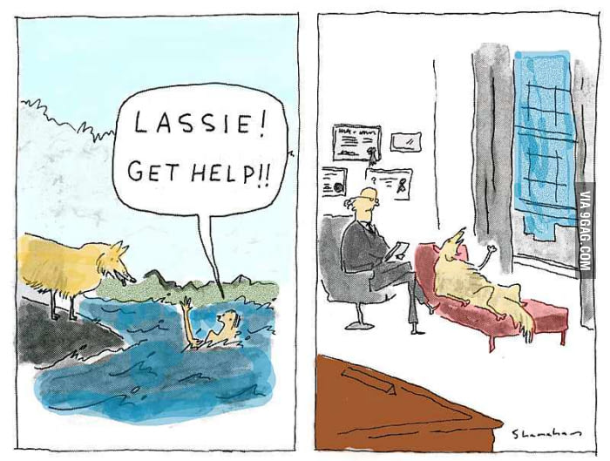
Why TIC Organizational Building is Important
Compassion Satisfaction: Positive feelings derived from one’s work making a meaningful contribution
Burnout: Low job satisfaction, feel powerless and overwhelmed
Compassion Fatigue: Profound emotional and physical exhaustion, erosion of empathy and hope for our clients and ourselves
Vicarious/Secondary Trauma: Fundamental beliefs change; numbness, sadness, and/or anger toward unfairness of the world; can lead to PTSD

Slide 21
Call to Action

